Slide 1
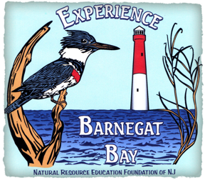
Lighthouse Center
for
Natural Resource Education
Waretown, NJ
Notes:
Welcome to our virtual tour of the Lighthouse Center for Natural Resource Education. I am Pola Galie, Operations Manager. I have lived at the Center since 2006 and assist with programs, fundraising and facility rentals. We appreciate the opportunity to introduce you to the place where you would have been visiting for the Barnegat Bay Educators’ Round Table. We look forward to seeing everyone at the Center next year.

Slide 2
Notes:
This is the Google Earth View of the Center. The center property is owned by the NJ Department of Environmental Protection’s Division of Fish and Wildlife and represents the longest stretch of the Barnegat Bay Shoreline that has never been developed. It is 194 acres of widely diverse habitat including vernal pools, maritime forest, its own watershed, shoreline and supports a large number of wild life. We have a variety of wildlife at the Center from song birds to shorebirds and mammals to quite a large group of snakes, turtles and frogs.

Slide 3
Center’s Past
Former site of the Lighthouse Vacation Center for the Blind
Summer home of Gladys Eayre and Janice Sherwood, 2 members of the Pine Coners. There were 2 Founding members of the Pinelands Cultural Society (Albert Hall).
Notes:
From the turn of the century until the mid-90s, the property was known as the Lighthouse Vacation Center for the Blind. During the 1980’s this property and the adjacent Bowker Family Homestead were identified as 2 of the top 100 properties in Ocean County to preserve. This was accomplished with the help of the NJ DEP Green Acres, Trust for Public Lands, Victoria Foundation and Doris Duke Foundation and preserved. The Natural Resource Education Foundation of NJ, a 501(c)(3) currently leases the property from the state.

Slide 4
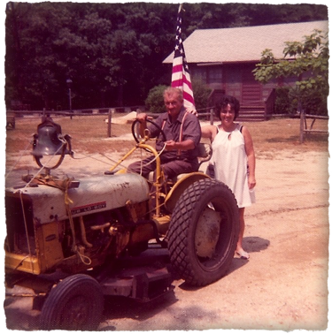
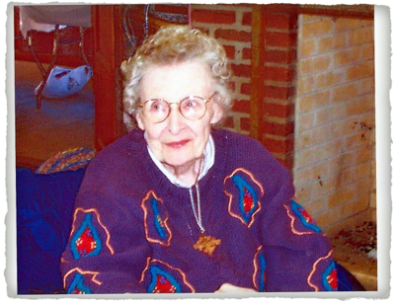
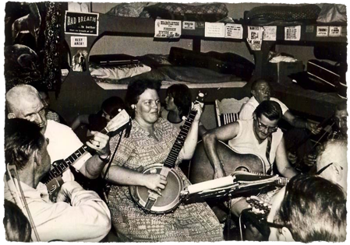
Elizabeth Morgan
Cecil Eayre and camper
Janice Sherwood & Gladys Eayre
Notes:
Many people like Elizabeth Morgan, Gladys and Cecil Eayre and Janice Sherwood are some of the local legendary people of the area who were instrumental in its history.

Slide 5
What we do
We aim to instill a strong
environmental ethic and
CALL TO ACTION in
the midst of having fun.

Slide 6
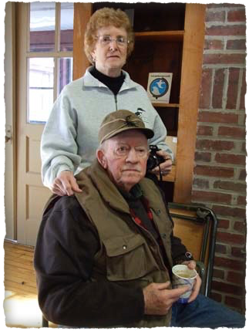
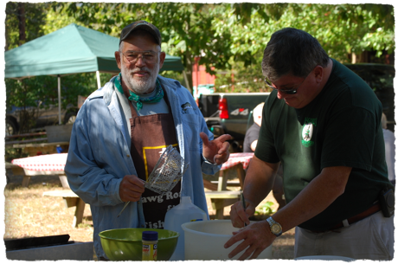
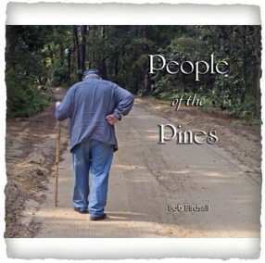
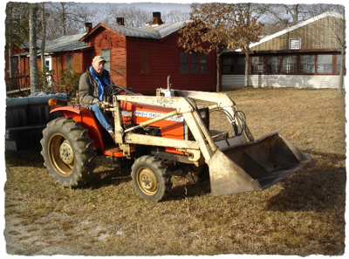
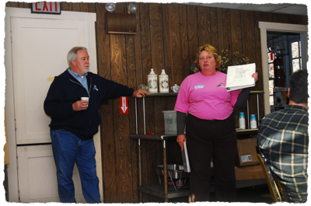
Some of our volunteers and supporters at events
Notes:
The Board of Directors, supporters and volunteers provide both support and programs. Over the years many people have been involved by conducting classes and workshops as well as pitching in to keep the Center up and running. Some of these folks included Ray & Barbara Nyman (top left), Dr. Roger Locandro (top right), Bill Fairgrieve (lower left) and Terry O’Leary and Christine Raabe (bottom right). The center is the cover photo of Bob Birdsall’s ”People of the Pines.”

Slide 7
Celebrating Barnegat Bay
Traditions
Conservation
Research
Education
Retreats/Conferences
Outdoor Activities
Music & handcrafts
Membership Programs
Jennifer Mylod
Notes:
The Board of Directors through the Experience Barnegat Bay Program try to introduce concepts of conservation and sustainability through experiential learning. Having fun, getting dirty and learning all at the same time. It works.

Slide 8
Recent Participants
Academy of Natural Sciences of Drexel University
Fish Hawks
Lord of Life Church
Marine Academy of Technology and Environmental Science (MATES)
Ocean County Soil Conservation District
Rider University
Rutgers University
Boy Scouts of Jackson Township
Other Schools, groups and organizations
Notes:
These are just a few of the groups, universities and schools that have had events/workshops at the Lighthouse Center for Natural Resource Education.

Slide 9
Volunteer Days/ Clean Ups
Notes:
We appreciate and enjoy working with groups of all sizes that volunteer to help get projects completed at the Center. We can customize school stays as well as volunteer days, weekends with groups. The Lighthouse Center is completely contributed by donations, grants and annual membership donations. We depend on volunteers for projects, program interpreters and events. We hope that you would like to join us some time.

Slide 10
What our visitors do . . .
Corporate meetings & retreats (single day/overnight)
Events/workshops
Educational activities
Church/School programs
Corporate Volunteer Days
Notes:
Just a few examples of what services we offer at the Lighthouse Center. Folks make great use of the diversity of nature and facilities there. Forests, freshwater pond, brackish impoundment and the shoreline that gives opportunities to enjoy nature or conduct approved research. There are meeting and class rooms available, a large dining hall and 2 full kitchens as well as 2 dormitories that sleep 24 each.

Slide 11
Barnegat Bay Environmental Educators Roundtable
Annual event sponsored by OCSCD
Teachers from throughout the state
Workshops
Syllabi
Easy on school budgets
Notes:
This would have been the 23rd Annual event if it hadn’t been interrupted by the restrictions mandated by the corona virus response.

Slide 12
Classroom sessions and Field Trips Offered
Notes:
At the BBEER teachers and supporters can participate in workshops, hands-on activities and other types of field trips. The choices are different and themed every year. It is an economical way for teachers to earn CEUs and informal teachers to network and be inspired.

Slide 13
Notes:
A map of the facility and it's trails. There are a wide variety of habitats and wildlife. There are abundant opportunities for wildlife observation.

Slide 14
Other Opportunities
Schools often offer their own programs with the Center as the classroom.
The Center also offers Instructor Led Learning Stations on a variety of subjects
Other activities can be arranged as well.

Slide 15
How your school or group can schedule an outing
Call 609-698-8003 or email info@nrefnj.org to arrange tour
Visit www.LighthouseCenterNJ.org/meeting-retreat-ctr
Fill out the facility request form and submit insurance certification

Slide 16
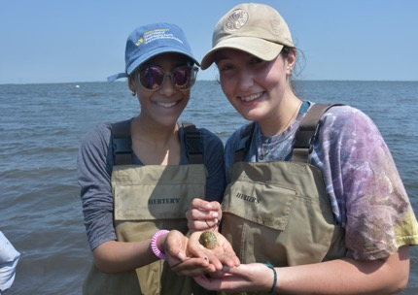
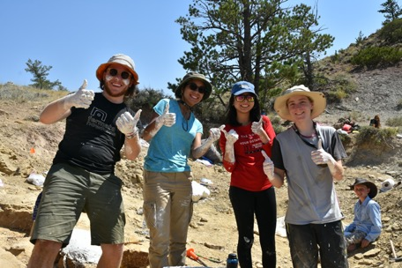
Focused on different habitats and areas of study!!
Open to High School Sophomores and Juniors
The Drexel Environmental Science Leadership Academy is one part adventure travel, one part leadership training, and two parts field experience. Students who attend DESLA have the choice of habitat-hopping from seaside to maritime forest all along the New Jersey coastline;
Tentative dates for 2020: July 12 - 18, 2020:
https://drexel.edu/coas/academics/high-school-programs/desla/

Slide 17
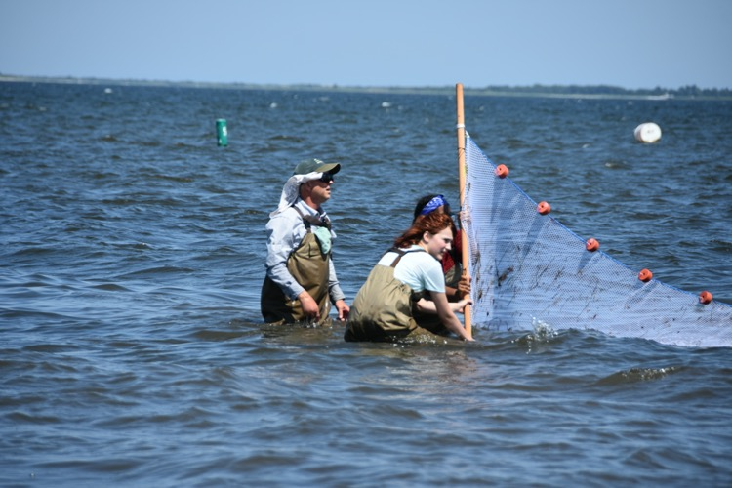
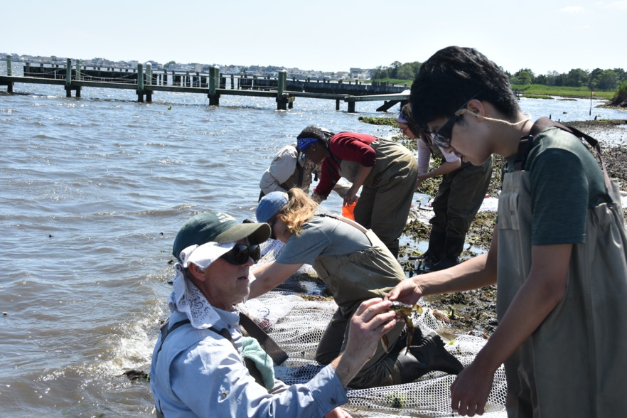
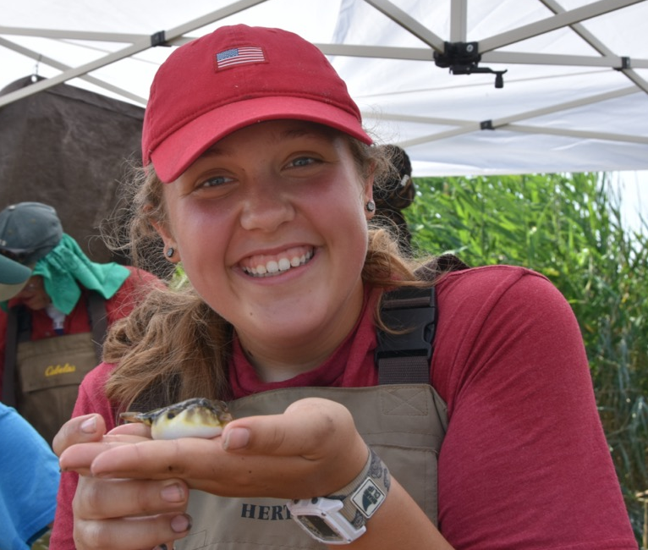
DESLA at the Lighthouse Center
Activities include, Fish & Wetlands Studies, Barnegat Water Quality, Beach Ecology, Herp Night, Pygmy Pine Forest Survey Algae Night and Bug Night

Slide 18
Fish Hawks
Fishing Seminar
Notes:
Every year the Fish Hawks with a grant from Exelon partnered with the Lighthouse Center to teach children of deployed military about fishing, crabbing and Barnegat Bay. Every child that participates goes home at the end of the day with a tackle box and fishing rod after a great barbecue lunch and a variety of fun activities.

Slide 19
White oak weaving
Wood duck conservation
Notes:
Learning about how oak is harvested, prepared and woven into heirloom baskets.

Slide 20
Nature Dyeing Workshop

Slide 21
Learning Station Programs Available*
About the Honeybee
Bay Life (seining activities - seasonal)
Diamondback Terrapins
Pioneer Homestead Investigations
Hidden Pond
Shorebirds
The Maritime Forest
Watershed Explorations
*There is a fee for interpreter led programs

Slide 22
Informal Programs*
Archery
Basketry
Birding Walk
Crabbing/Fishing (seasonal)
Fish Printing or Flatty Painting
Sing-A-Long
Weaving on Cardboard Loom
*There is a fee for interpreter led programs

Slide 23
Music By the Bay
Annual Retreat
Since 2007!
Notes:
Unless cancelled or postponed by natural disaster or weather, the Music By the Bay event has been happening since 2007. In honor of Gladys Eayre and Janice Sherwood, we host music and craft workshops, concerts and jams. Always a great time and a great fundraiser for the Center.

Slide 24
Learn about
pollinators

Slide 25
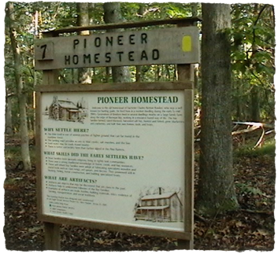
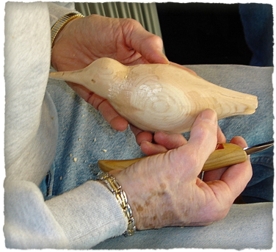

Slide 26
2020 Plans
In light of the current situation, we are wondering when we can start to have in-person events & rentals. It’s our hope that this summer we can offer:
A fun(d)raising BBQ and handcraft event
Clean Up Days
Membership presentations
We are still scheduled for
Fish Hawks Fishing Seminar June 13th
Music By the Bay Retreat November 7th
What can we plan together?

Slide 27
More fun and education to come
Music, ecology, science,
dance, woodworking, archery,
weaving, art, journaling. . .
so much more.

Slide 28
Shoreline Restoration
Since losing a significant amount of shoreline over the past number of years, we are endeavoring to find funding for a shoreline restoration project. We are planning on using Wave Attenuation Devices (WADs).
We hope to have good news to report over the next year but in the meantime; we have already completed the design and are working on obtaining the permits.
The Board of Directors continues to work with our partners in an effort to secure the necessary approvals and funding.
We believe that working in partnership with nature will get results

Slide 29
Natural Resource Education Foundation of NJ Board of Directors
Chris West
Joseph Bonacci
Peter Winkler, NJ Division of Fish and Wildlife
Pola Galie, Operations Manager
George Snyder, Facility Manager
McDuffy Barrow, Naturalist
Nancy Eriksen, President
Paul Jivoff, Ph.D, Vice President
Christine Raabe, Secretary
Janet Heller, Treasurer
Mary Carty, Assistant Treasurer
Jack Henderson
Laine Meelheim

Slide 30
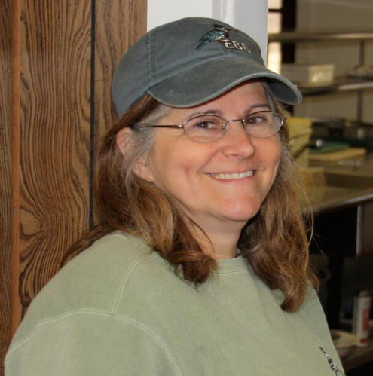
Please feel free to contact me with questions.
We hope to see you at the Center
–Pola Galie pgalie@nrefnj.org
609-698-8003 Visit us online www.LighthouseCenterNJ.org

