Slide 1
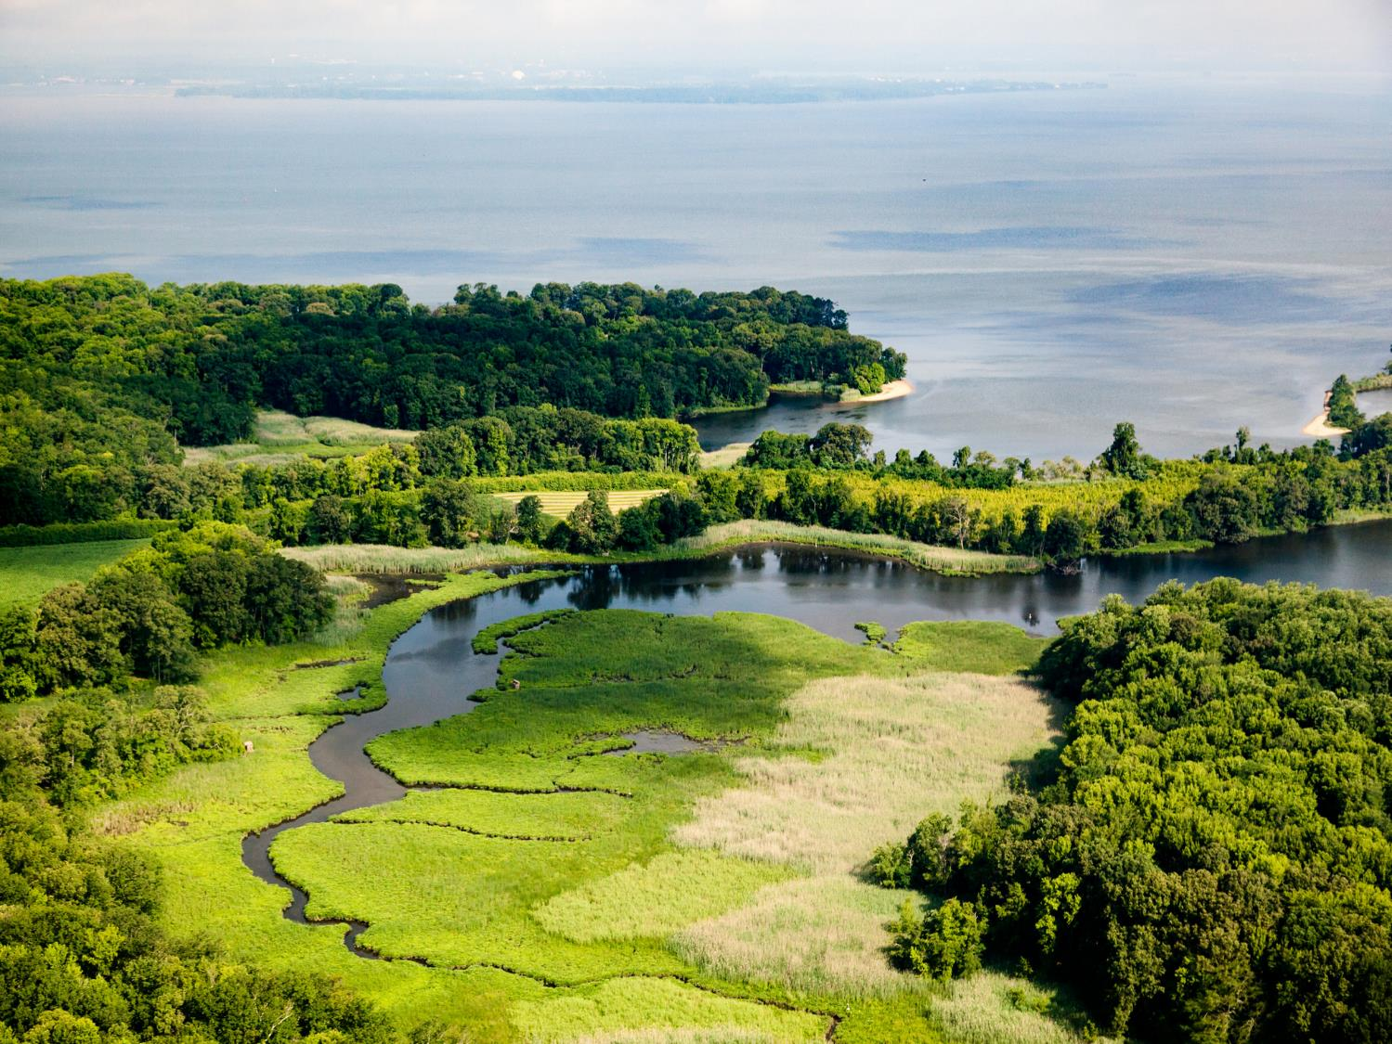
Watersheds – Our Water, Our Home

Slide 2

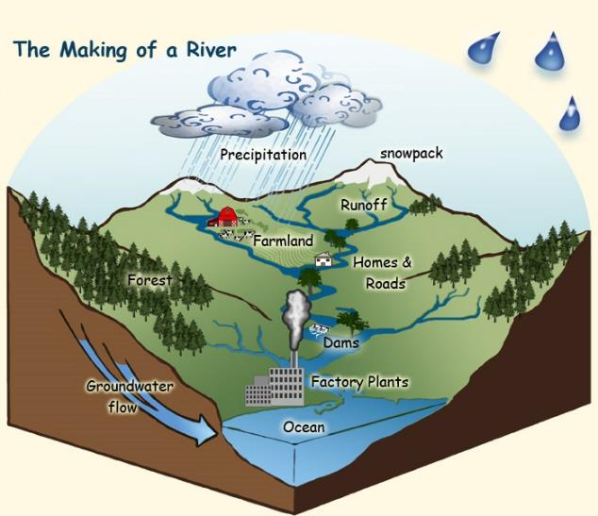


What is a Watershed?
Notes:
A watershed is land that sheds water. Water from rain or snow can flow over the land it falls on. The water can flow to a river, lake, stream or ocean. All of the water under or draining off of a particular watershed goes into the same place. Watersheds come in all shapes and sizes. They cross county, state and national boundaries. Some are millions of square miles, others are just a few acres. Homes, farms, ranches, forests, small towns, big cities and more can make up watersheds. You're sitting in a watershed now.

Slide 3

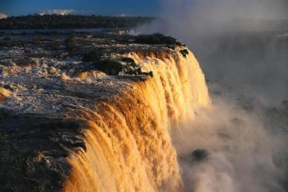
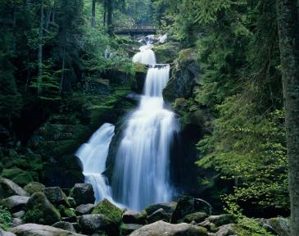
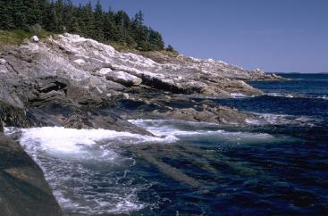
How does Water flow in a Watershed?
Notes:
Gravity helps the rain, sleet, and snow flow from the ground to join the rest of the water in the oceans, lakes, rivers, streams, or ponds.

Slide 4
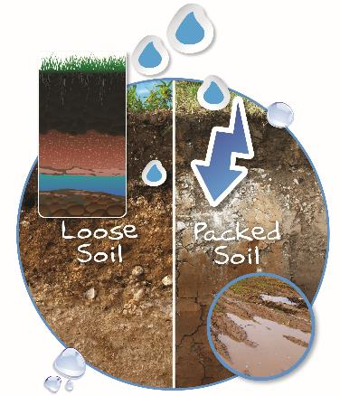
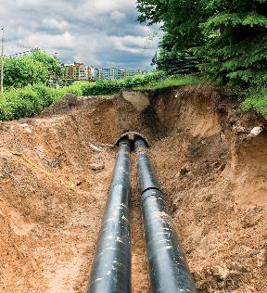
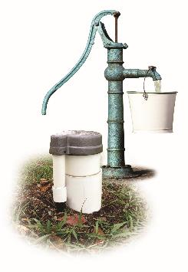
Flowing through the Watershed
Notes:
Water can also soak into the soil until it reaches underground rivers or aquifers. Some rain, sleet, and snow soak into the ground where it is stored as ground water. Groundwater is water that moves through spaces in soil and rock underground.

Slide 5

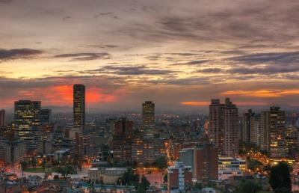
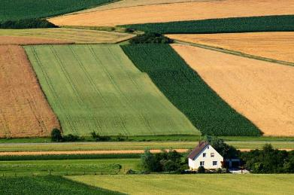
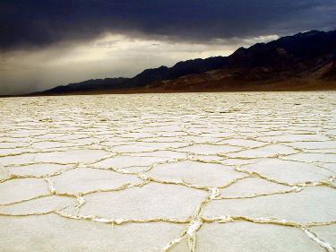
Not all Watersheds are Alike
Notes:
Watersheds can vary greatly in climate, animal life, plant life, human population, amounts of water, and size. Even the desert known as Death Valley is part of a watershed – the Bad Water Basin Watershed. Deserts typically receive ten inches or less of precipitation per year. The rain usually comes in brief downpours resulting in flooding as the water flows across the dry, caked soil. Remember, not all water in a watershed is above ground. Even in the desert, there are underground rivers and aquifers where water flows.

Slide 6

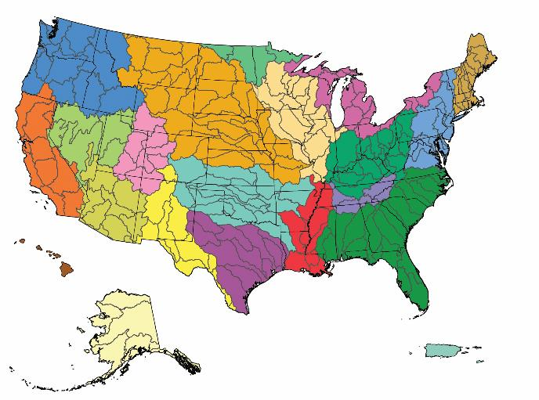
Where is the Watershed?
Notes:
Everywhere! Remember, every piece of land on the planet is part of a watershed. In the continental US, there are 2,100 watersheds. If Hawaii, Alaska, and Puerto Rico are included, the count rises to 2,267 watersheds.

Slide 7
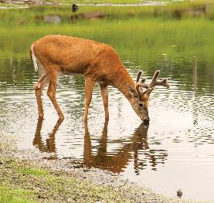
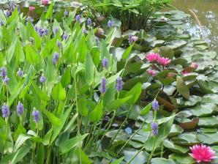
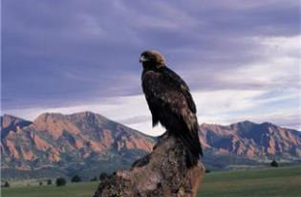
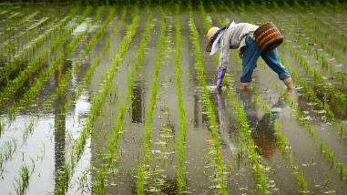
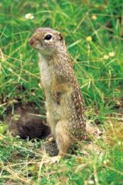
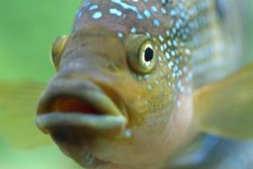
Who Lives in the Watersheds?
Notes:
You and everyone you know lives in a watershed. We share the water in our watershed with other people, with animals and with plants. We all live in the watershed.

Slide 8
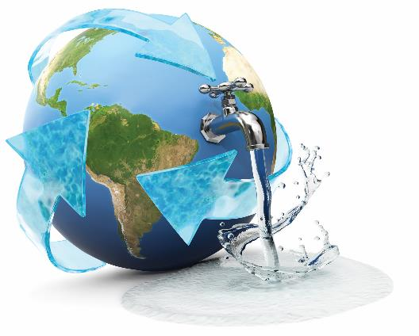
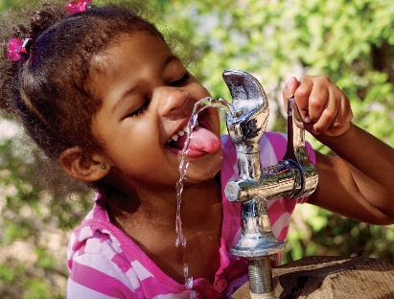
Drinking Shed Water
Notes:
Some of the water you drink comes from your watershed! Water from the watershed drains into lakes, rivers, and streams or through the soil into ground water. The world’s fresh water supply is not new. Our water is being constantly recycled through the earth’s water cycle. A drink of water, whether from a fountain, faucet, or bottle, could be thousands of years old and may have travelled around the world a few times.

Slide 9
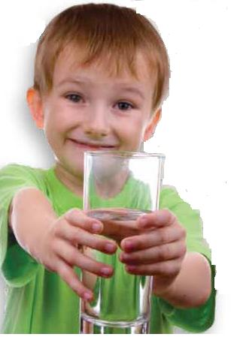
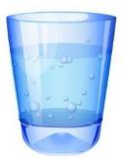
Clean Water is Important
Notes:
The way we treat the land in our watersheds can have a big impact on the water we drink. We each need to drink eight glasses of clean water every day to help keep us healthy. We all need clean water to drink and use in our daily lives. It is very important to take good care of our watershed.

Slide 10
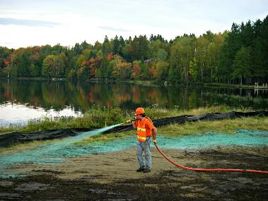
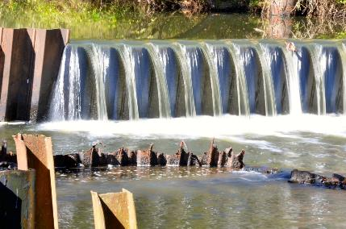
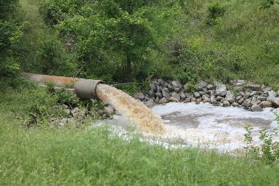
Watershed Conservation
Notes:
We all need to work hard to keep our watershed clean. It is important to take good care of our watershed so that we have fresh, clean water. Only 1% of the water on our planet is fresh useable water. The average person uses 70 gallons of water every day! Tell your family and friends how important it is to practice good conservation habits in your watershed.

Slide 11
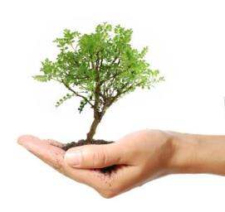
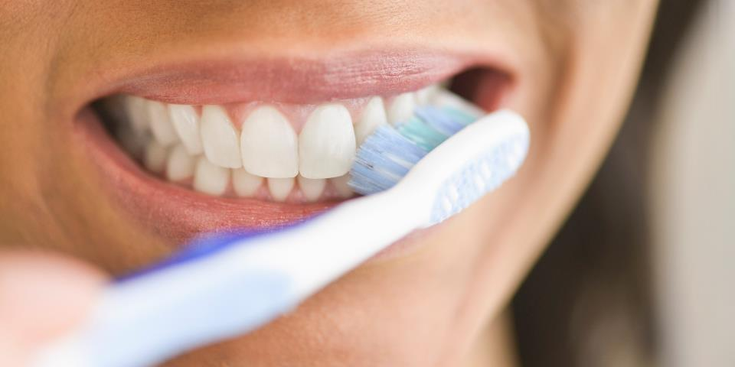
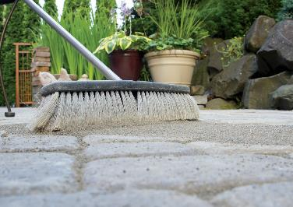
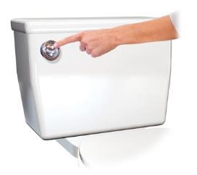
Take action – your drinking water depends upon it
Notes:
Our daily habits are very important to the health of our watershed and our water! Some of our habits keep our watershed healthy, and some of them can harm it.
Turn water off while brushing teeth and flush down toilet. Use a broom instead of a hose to clean sidewalks. Cover bare soil by planting trees, shrubs, flowers, and other plants.

Slide 12
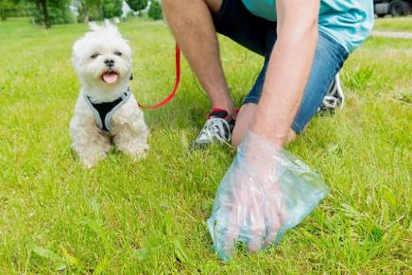
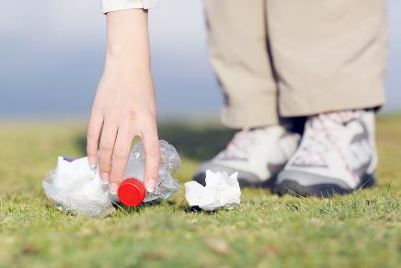
Take Action:
Be a Picker Upper!
Notes:
Pick up litter so that it doesn’t end up in a river, lake, or stream. Six out of every 10 homes have a four-legged pet. Do you? Care for your watershed by disposing of pet waste in the trash or toilet. Proper disposal means proper treatment. Pet waste left on the ground can wash into storm drains and ditches. From there it flows into lakes and streams where it can contaminate the water with harmful bacteria.

Slide 13

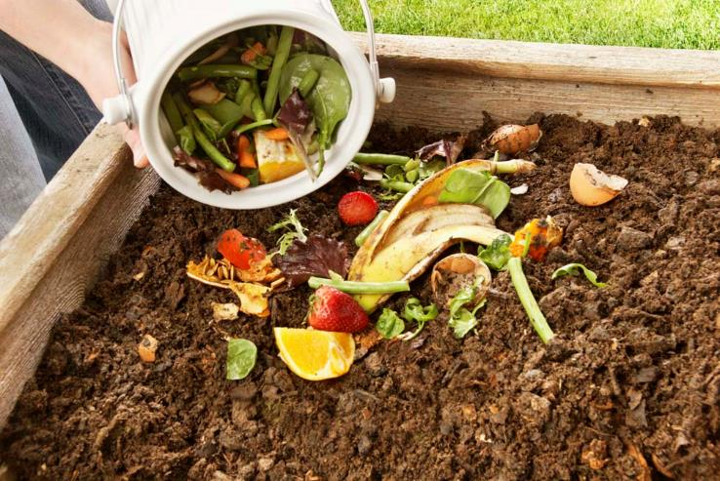
Take Action:
Compost
Notes:
Compost leaves, grass, and food. Compost makes a great natural fertilizer and helps keep chemicals out of our water supply.

Slide 14

Take Action:
Recycle
Notes:
Recycling saves water and other natural resources. Water vapor in the atmosphere condenses to form clouds and weather systems that can travel around the world. Eventually the condensation becomes precipitation in the form of rain, snow, sleet, hail, or fog. Once the precipitation lands, it can do two things: it can be SHED off the land into a body of water like a stream – OR it can soak through the soil until it reaches an underground body of water like an aquifer. Water re-enters the atmosphere to start the cycle all over again by evaporation and transpiration. (click) rain on plant, (click) diagram of soil.

Slide 15
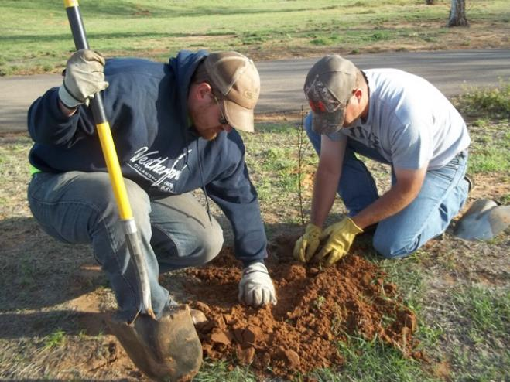
Take Action:
Plant and Grow
Notes:
Plant trees, shrubs, and other plants in spots where the soil is bare. Plants help hold the soil in place and keep it from washing into storm drains. If there are bare spots in your yard, get busy planting. Plants prevent erosion which leads to soil being moved through the watershed into our lakes and rivers. Grow some healthy vegetables like broccoli or tomatoes. (click) planting, (click) flowerbed, (click) broccoli, (click) tomato.

Slide 16

What is your community doing to protect your water and watershed?
Notes:
Your local conservation district is eager to help you care for your watershed. Contact them for information.

Slide 17

2018
POSTER CONTEST

Slide 18
Poster Contest Details
The national winning poster will be used for local and state level promotion materials.
Send entries to your local conservation district
http://www.nacdnet.org/general-resources/conservation-district-directory/
Find out the entry deadline for your local contest!!!!
Contest Categories Below May Differ Between States:
  K-1st Grade
  2nd-3rd Grade
  4th-6th Grade
  7th-9th Grade
  10th-12th Grade

Slide 19
Poster Contest Details
Winning entries will be selected by your local district and sent to the state level for judging.
State winner entries will then be sent to the national level, where one overall winner will be selected and announced at the 2019 NACD Annual Meeting in San Antonio, TX. Winners will be posted to the NACD website.
Monetary prizes will be awarded to the 1st - 3rd place winners in each category at the national level.
  $200 for 1st Place Winners
  $150 for 2nd Place Winners
  $100 for 3rd Place Winners
Monetary awards from the NACD Auxiliary & Albert I. Pierce Foundation

Slide 20

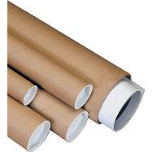
Poster Contest Details
Turn poster in on time for judging. Ocean County Soil Conservation District’s local entry deadline is March 3, 2018.
Attach poster entry form on the back of each poster and be sure it is signed by a parent or guardian.
Entry must be contestant's original creation and may not be traced from photographs or other artists' published works.

Slide 21
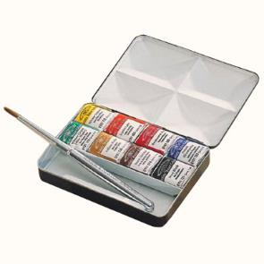
Poster Contest Details
Any media may be used to create a flat poster
  Paint
  Crayons
  Colored pencil
  Charcoal
  Stickers
  Paper

Slide 22
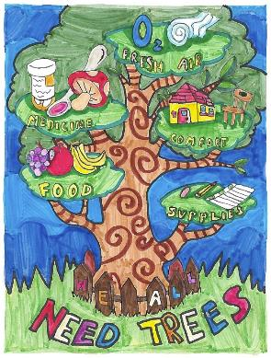
What makes a good Poster?
Attracts attention
Is simple and concise
Uses colors and white space effectively
Text is large enough to be easily read

Slide 23
Brainstorming Poster Ideas
Research the topic of the theme
Brainstorm ideas and make a list
Use the theme as your title:
  Watersheds – Our Water, Our Home
Use some of the important water issues from this presentation.
Look around your community for ideas.
Talk to professionals in the industry.
Research watersheds online and use the information found in your poster.

Slide 24
Dos:
  Do limit text, and balance a combination of illustrations and words.
  Do be as neat as you can and be sure to erase any penciled sketches or guidelines.
  Do blend colors when using crayons or colored pencils.
  Do research the theme topic as a way to brainstorm poster ideas.

Slide 25
Don’ts:
  Don’t use staples, tacks, or tape.
  Don’t use fluorescent-colored posters.
  Don’t create a poster that is all words or all illustrations.
  Don’t have your parent or others draw your poster for you to color in.
  Don’t try to include too many ideas. A single message – clearly illustrated – is most effective.

Slide 26
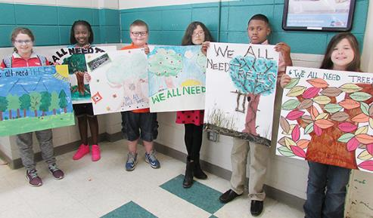
Judging Criteria
Conservation message—50 percent
Visual effectiveness—30 percent
Originality—10 percent and
Universal appeal—10 percent

Slide 27
For Additional NACD Information
Visit http://www.nacdnet.org/general-resources/stewardship-program/
Entry Forms, Rules, and Resource PDF files are also available for download on the contest page.
http://www.nacdnet.org/education/contests

